Slide 1
SYSTEM DESIGN AND Construction
SEGMENT-5

Slide 2
TEAM WIZARD
Team Members:
Raj Chowdhury
ID: C221086
Mojahadul Alam ID: C221096

Slide 3
TABLE CONTENT
The design process
The design process (and why it is important)
Design process steps
The importance of the design process
Design Methodologies
Structured Design
Data Input Methods
Designing Effective Output
Forms Design
Good design and Bad Design
Client Information Input Form
Product Details
Input Form
Database Design

Slide 4
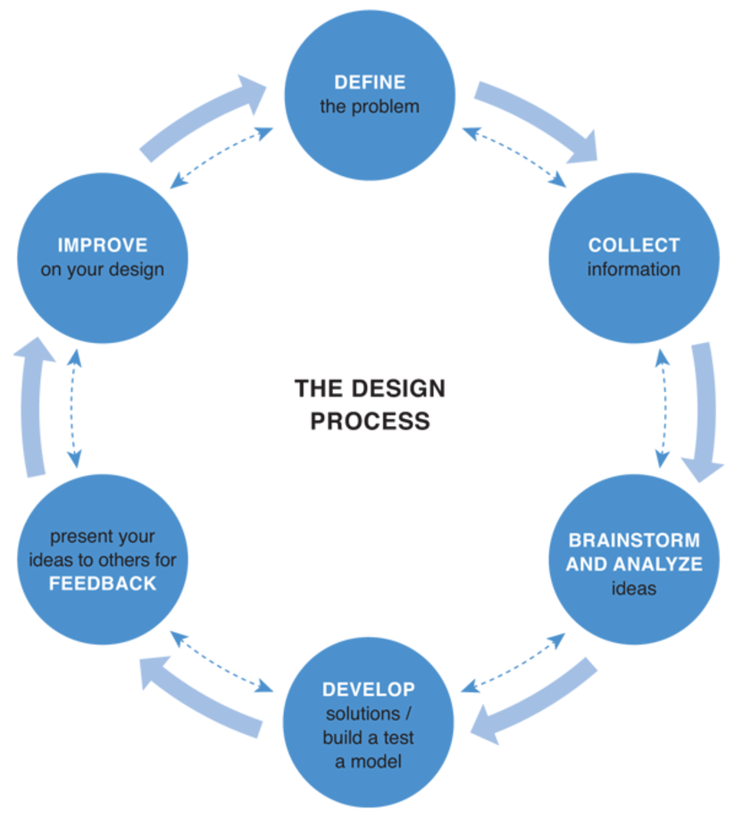
THE DESIGN PROCESS
Think of any digital experience or product you’ve enjoyed in your everyday life, like scrolling Instagram or TikTok for hours on end, , looking up travel destinations on Google, or ordering groceries through Daraz. Each of these digital products have countless features that are thoughtfully designed and highly performant — but that wasn’t always the case

Slide 5
Do you know why The design process it is important?
The design process is very important to non-designers, too. For example, when you’re designing a digital product, cross-functional team members such as product managers ,researchers ,analysts, developers, and other stakeholders have valuable input for what is being designed. The design process makes it easier for those different individuals to get involved at the right time, such as during market research, user testing, and Design Delivery.

Slide 6
The Design process has five main steps
Step 1: Empathize : The first step in the design process, also referred to as “Discovery”, involves the same initial effort required for any new business challenge: identifying and empathizing with your target user and their needs.
Step 2 : Define : What have you learned about your user? What problems are they running into? How are they currently dealing with them? These are some questions to answer at the second step of the design process, which is all about defining your problems, goals and boundaries.
Step 3 : Ideate : The third step of the design process is what most people envision when they think of a designer’s creative process.
Step 4 : Deliver : The deliver step of the design process is the turning point when designs begin to feel real because they are shared with others in the form of a prototype or MVP.
Step 5 : Test : When designing digital products and experiences today, you’ll rarely find a designer designing something and never touching it again.

Slide 7
Benefits of the design process? Here are some specific positive benefits of a solid design process:
1.Set clearer expectations : While an individual designer’s creative process might be somewhat chaotic and messy, the design process as a whole is not.
2. Improve teamwork and alignment : You can have the most talented design team in the world, but it doesn’t matter if there isn’t clarity and a common workflow that gets everyone working in sync.
3. Create more efficiently : The design process is like a workflow template to follow, and we all know that templates help us all work faster.
4. Gain happy users : The ultimate goal for any design project is not just to solve a problem, but to also make users happy.

Slide 8
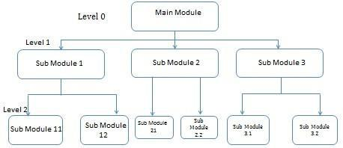
DESIGN METHODOLOGIES
Top-Down Strategy : The top-down strategy uses the modular approach to develop the design of a system. It is called so because it starts from the top or the highest-level module and moves towards the lowest level modules.

Slide 9
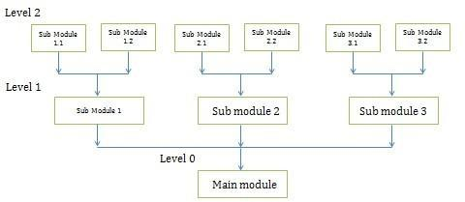
DESIGN METHODOLOGIES
Bottom-Up Strategy : Bottom-Up Strategy follows the modular approach to develop the design of the system. It is called so because it starts from the bottom or the most basic level modules and moves towards the highest level modules

Slide 10
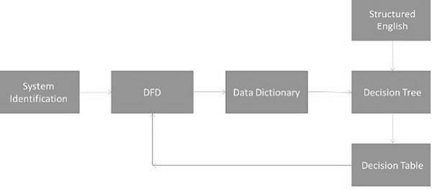
STRUCTURED DESIGN
Structured design is a data-flow based methodology that helps in identifying the input and output of the developing system. The main objective of structured design is to minimize the complexity and increase the modularity of a program. Structured design also helps in describing the functional aspects of the system.

Slide 11
DATA INPUT METHODS
It is important to design appropriate data input methods to prevent errors while entering data. These methods depend on whether the data is entered by customers in forms manually and later entered by data entry operators, or data is directly entered by users on the PCs.
Some of the popular data input methods are −
• Batch input method (Offline data input method).
• Online data input method.
• Computer readable forms.
• Interactive data input.

Slide 12
FORMS DESIGN
Both forms and reports are the product of input and output design and are business document consisting of specified data. The main difference is that forms provide fields for data input but reports are purely used for reading. For example, order forms, employment and credit application, etc.

Slide 13
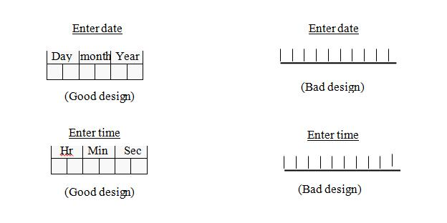
GOOD DESIGN AND BAD DESIGN
Here is a figure of good design vs bad design. You can see that in good design format fields are well specified. But in a bad design format fields are not specified. We will see an example of good design form next.

Slide 14
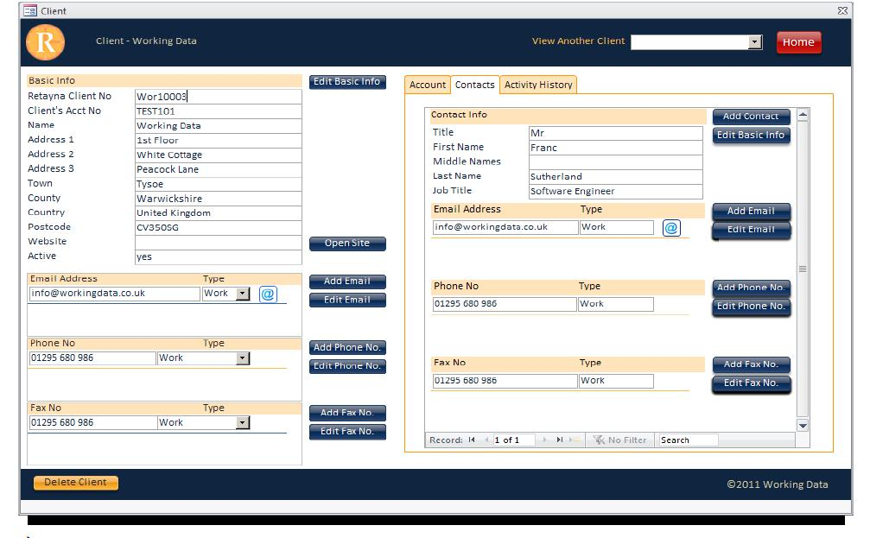
CLIENT INFORMATION INPUT FORM
Here we can see a client information form. In this form fields such as name, address, email etc. are well specified. User can easily understand what information to put in a box.

Slide 15
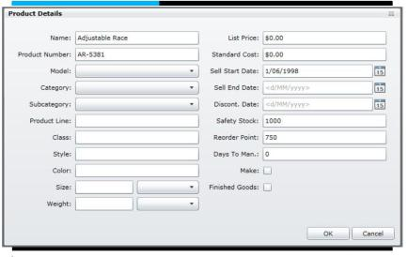
PRODUCT DETAILS INPUT FORM

Slide 16
DATABASE DESIGN
1. Conceptual database design - to build the conceptual representation of the database, which has the identification of the important entities, relationships, and attributes.
2. Logical database design - to convert the conceptual representation to the logical structure of the database, which includes designing the relations (ERD).
3. Physical database design - to decide how the logical structure is to be physically implemented (as base relations) in the target Database Management System (DBMS).

Slide 17


Slide 18
THANK YOU!!!

